Slide 1
Unit2
Addressing modes in 8085 microprocessor

Slide 2
Registers in 8085:
(a) General Purpose Registers –
The 8085 has six general-purpose registers to store 8-bit data; these are identified as- B, C, D, E, H, and L.
These can be combined as register pairs – BC, DE, and HL, to perform some 16-bit operation.
These registers are used to store or copy temporary data, by using instructions, during the execution of the program.

Slide 3
(b) Specific Purpose Registers –
Accumulator:
The accumulator is an 8-bit register (can store 8-bit data) that is the part of the arithmetic and logical unit (ALU). After performing arithmetical or logical operations, the result is stored in accumulator. Accumulator is also defined as register A.

Slide 4
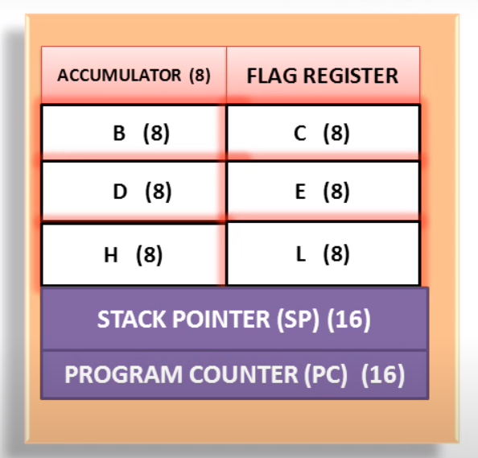

Slide 5
Addressing Modes

Slide 6
Addressing Modes– The term addressing modes refers to the way in which the operand of an instruction is specified.

Slide 7
Types of addressing modes –
In 8085 microprocessor there are 5 types of addressing modes:

Slide 8
Immediate Addressing Mode –
In immediate addressing mode the source operand is always data. If the data is 8-bit, then the instruction will be of 2 bytes, if the data is of 16-bit then the instruction will be of 3 bytes.
Examples:
MVI B 45 (move the data 45H immediately to register B)
LXI H 3050 (load the H-L pair with the operand 3050H immediately)
JMP address (jump to the operand address immediately)

Slide 9
Register Addressing Mode –
In register addressing mode, the data to be operated is available inside the register(s) and register(s) is(are) operands. Therefore the operation is performed within various registers of the microprocessor.
Examples:
MOV A, B (move the contents of register B to register A)
ADD B (add contents of registers A and B and store the result in register A)
INR A (increment the contents of register A by one)

Slide 10
Direct Addressing Mode –
In direct addressing mode, the data to be operated is available inside a memory location and that memory location is directly specified as an operand. The operand is directly available in the instruction itself.
Examples: LDA 2050 (load the contents of memory location into accumulator A) LHLD address (load contents of 16-bit memory location into H-L register pair) IN 35 (read the data from port whose address is 35)

Slide 11
Register Indirect Addressing Mode – In register indirect addressing mode, the data to be operated is available inside a memory location and that memory location is indirectly specified by a register pair.
Examples: MOV A, M (move the contents of the memory location pointed by the H-L pair to the accumulator) LDAX B (move contents of B-C register to the accumulator) LXIH 9570 (load immediate the H-L pair with the address of the location 9570)

Slide 12
Implied/Implicit Addressing Mode –
In implied/implicit addressing mode the operand is hidden and the data to be operated is available in the instruction itself.
Examples:
CMA (finds and stores the 1’s complement of the contents of accumulator A in A)
RRC (rotate accumulator A right by one bit)
RLC (rotate accumulator A left by one bit)

